Slide 1
A Brief Introduction to
GAM
Fish 559; Lecture 23
Notes:
a

Slide 2
Linear regression &
additive modelling
Generalised linear
modelling & generalized
additive models
Allow for:
Nested data
Temporal correlation
Spatial correlation
Heterogeneity
Repeated measurement
Mixed modelling &
additive mixed modelling
Generalised linear mixed
modelling & generalised
additive mixed modelling
Zuur et al.; Fig. 15.1

Slide 3
Why GAMs Anyway?
A GAM is:
  “a GLM in which part of the linear predictor is specified in terms of smooth functions of predictor values”
GLMs and GAMs have tended to become more similar in recent years (you can, for example, refer to splines when applying lm).

Slide 4
Why GAMs Anyway?
GAMs use a basis-expansion
i.e. X is transformed to yield smoothing covariates
Some GAMs also use a smoothing spline
Automatically estimates smoothness

Slide 5
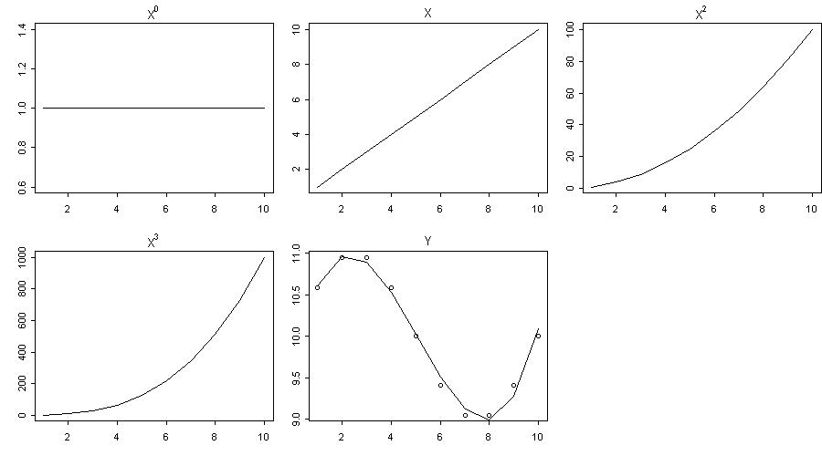
Polynomial basis expansion

Slide 6
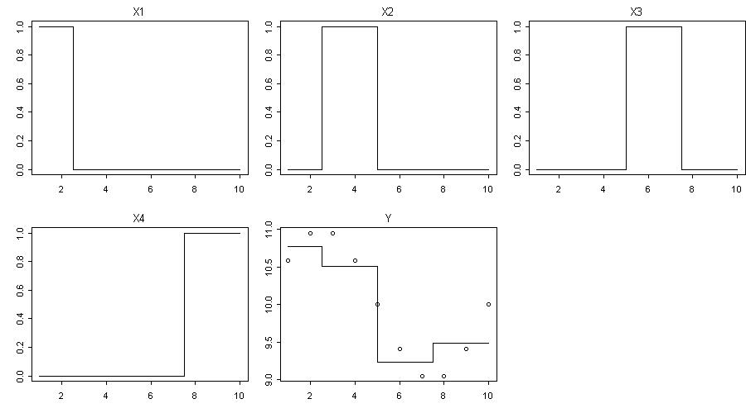
0-th order spline basis expansion

Slide 7
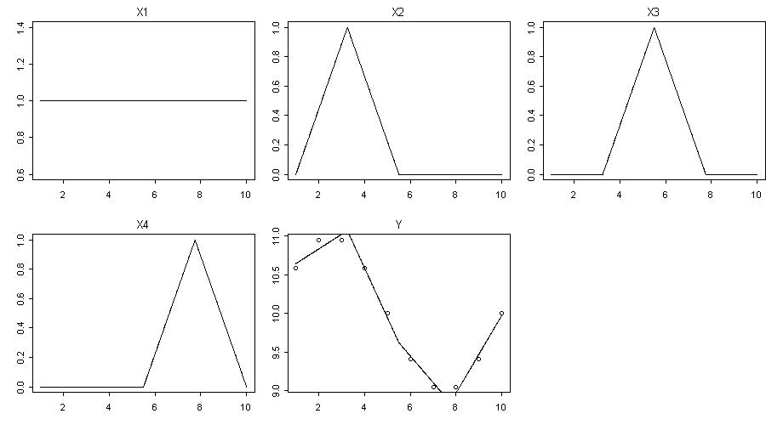
1st order spline basis expansion

Slide 8
2nd order spline basis expansion

Slide 9
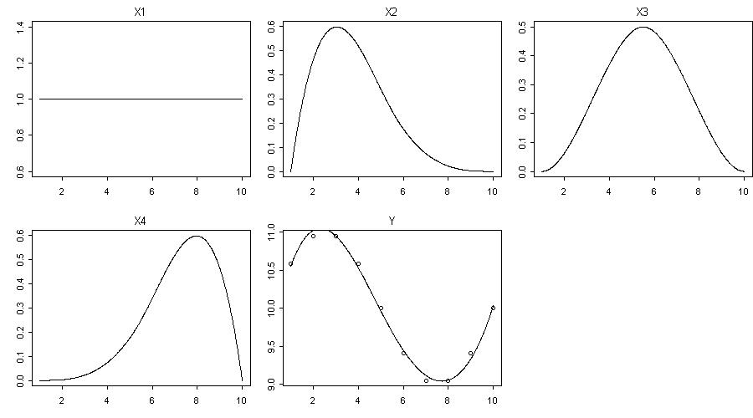
3rd order spline basis expansion

Slide 10
BackGround-I
Additive models are based on fitting a set of one-
dimensional smooth functions to the data. GAMs extend
smoothers (e.g. loess) [although loess is still useful when
conducting data exploration].
Output <- loess(yy~xx,span=y)

Slide 11
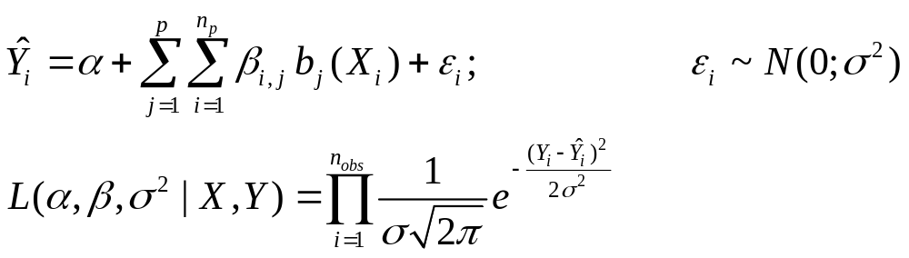
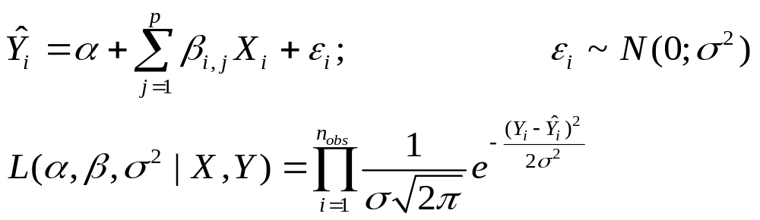
Background-II
In its simplest form a fixed-knot GAM is given by:
b_{j}(X_{i}) is a basis expansion for variable X_{i}
This compares with a LM:

Slide 12
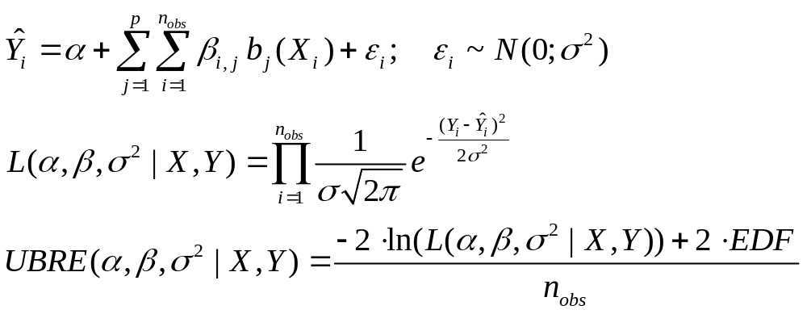
Background-III
Smooth splines use an additional penalty on spline coefficients
EDF: effective degrees of freedom
Calculated using Trace(Β)
Rescaled AIC

Slide 13
GAM Packages
GAM implementations
gam in gam: not recommended
gam in mgcv: contains more of what we need
GAMM implementations
gamm in mgcv: uses nlme package
gamm4 in lme4: uses lme4 package

Slide 14
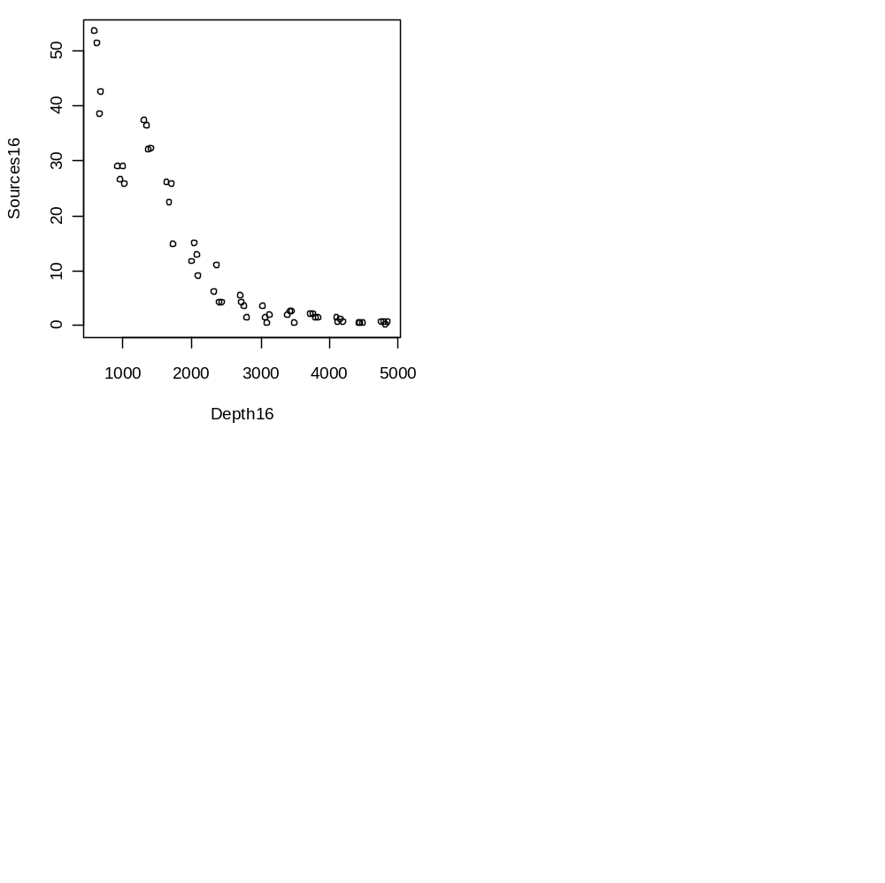
Example from Zuur-I
Data on pelagic bioluminascence
versus depth for “cruise 16”
(source: Zuur et al.)
This function is not linear and
there may be “something” at
1500m

Slide 15
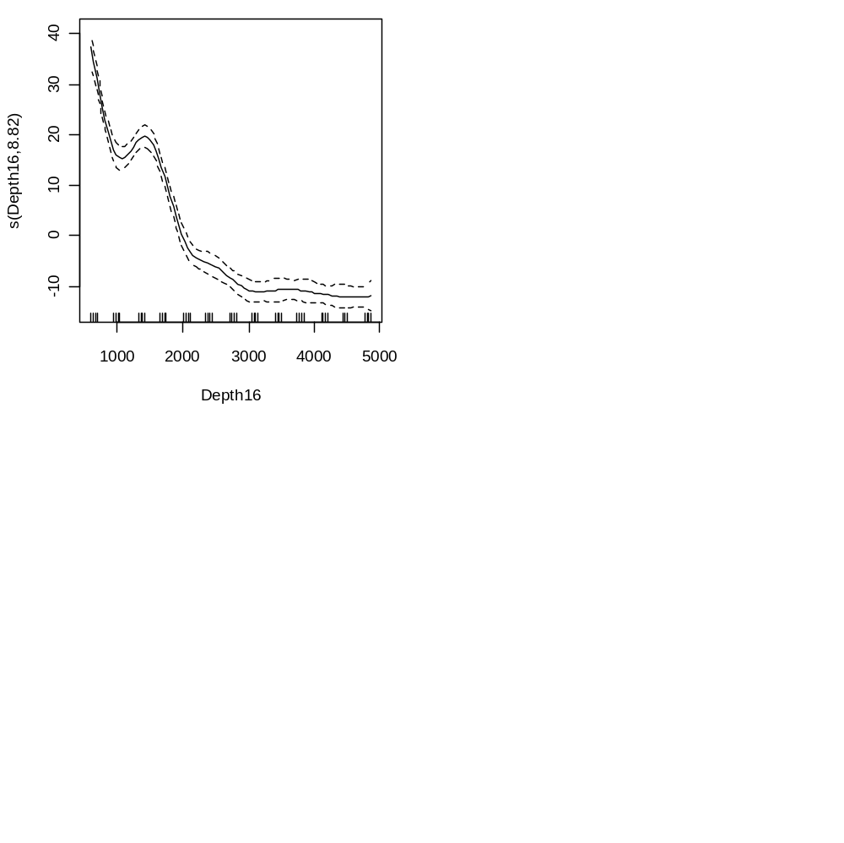
Example from Zuur-II
M3 <- gam(Sources16 ~ s(Depth16,fx=FALSE, k=-1,bs="cr"))
plot(M3,se=TRUE)
s = smoothing spline
fx = use cross validation to
select the number of
degrees of freedom
cr = cubic regression spline

Slide 16
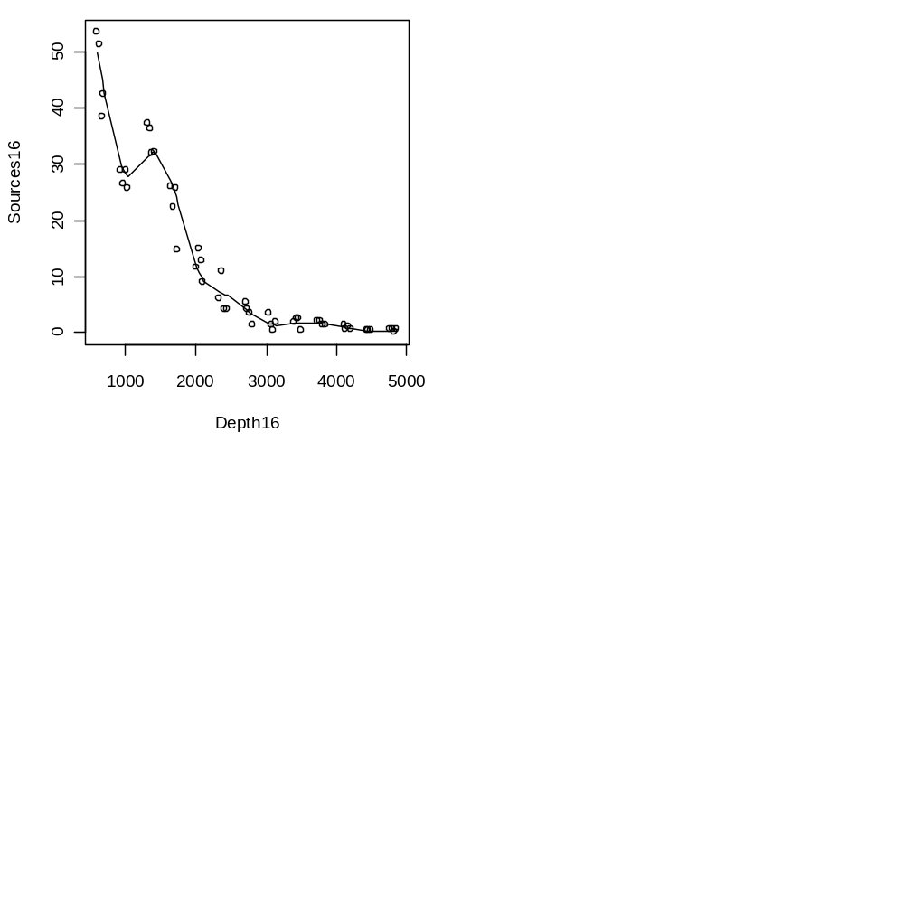
Example from Zuur-III
Predicted fit
(using predict)

Slide 17
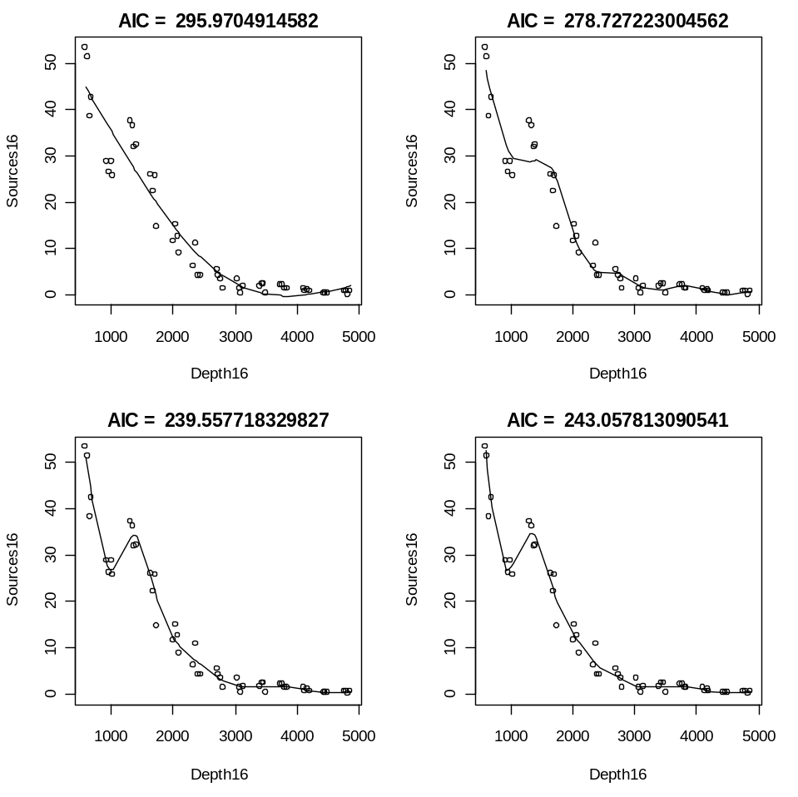
Model Selection (for Knots)
I used XX$aic to extract
the AIC

Slide 18
Multiple predictors-I
Moving to multiple predictors (a spline and a factor):
M4 <- gam(So ~ s(De) + factor(ID), subset = I1)

Slide 19
Multiple predictors-II
Family: gaussian Link function: identity
Formula:
So ~ s(De) + factor(ID)
Parametric coefficients:
Estimate Std. Error t value Pr(>|t|)
(Intercept) 19.198 1.054 18.207 < 2e-16 ***
factor(ID)13 -12.296 1.397 -8.801 7.59e-13 ***
---
Signif. codes: 0 ‘***’ 0.001 ‘**’ 0.01 ‘*’ 0.05 ‘.’ 0.1 ‘ ’ 1
Approximate significance of smooth terms:
edf Ref.df F p-value
s(De) 4.849 5.349 16.19 7.47e-11 ***
R-sq.(adj) = 0.695 Deviance explained = 71.9%
GCV score = 38.802 Scale est. = 35.259 n = 75
Formula
Parameter estimates
Explained variance, etc.

Slide 20
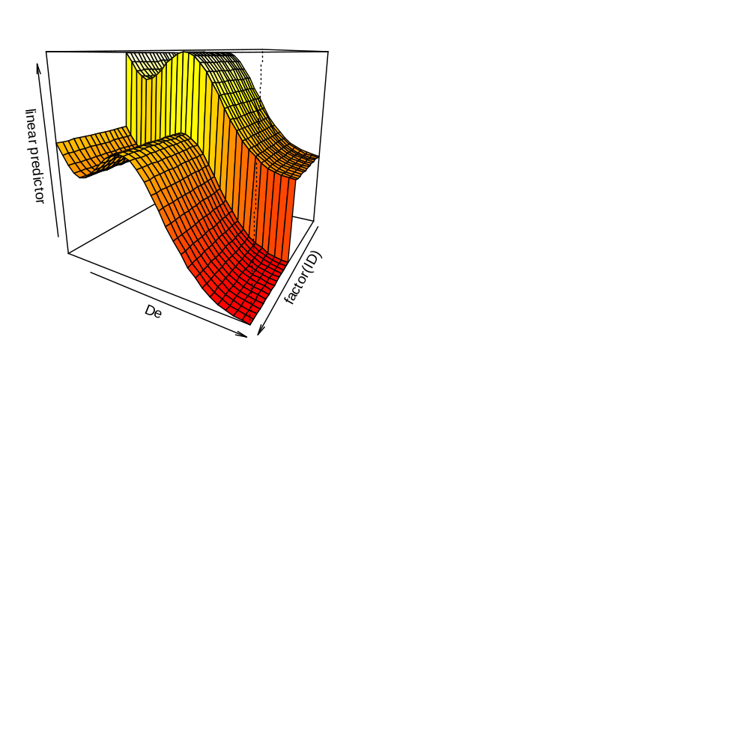
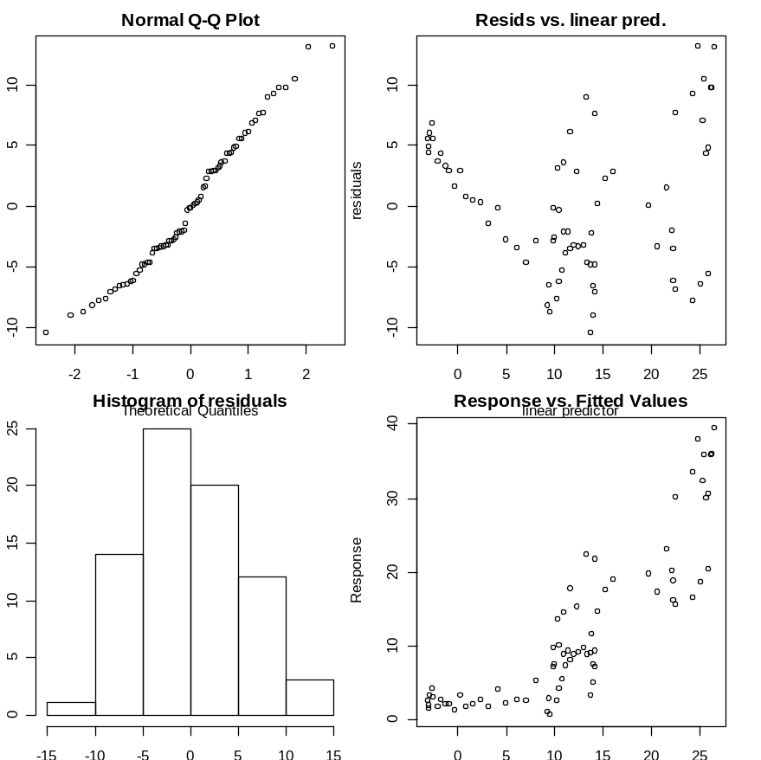
Diagnostics
vis.gam(M4,theta=120,color="heat")
gam.check(M4)

Slide 21
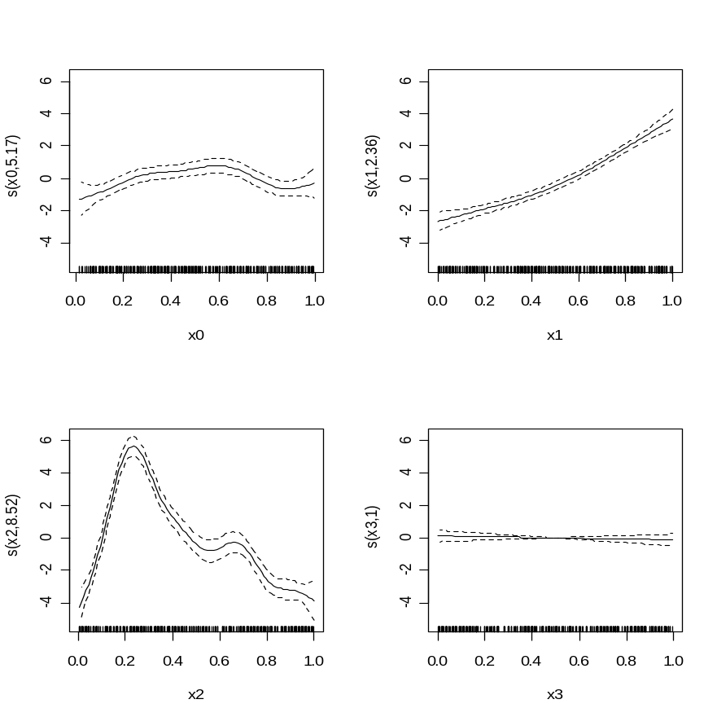
Multiple Predictors III
GAM terms are additive so
one can plot each in turn.
However, making predictions
of surfaces (over all covariates)
is often more meaningful

Slide 22
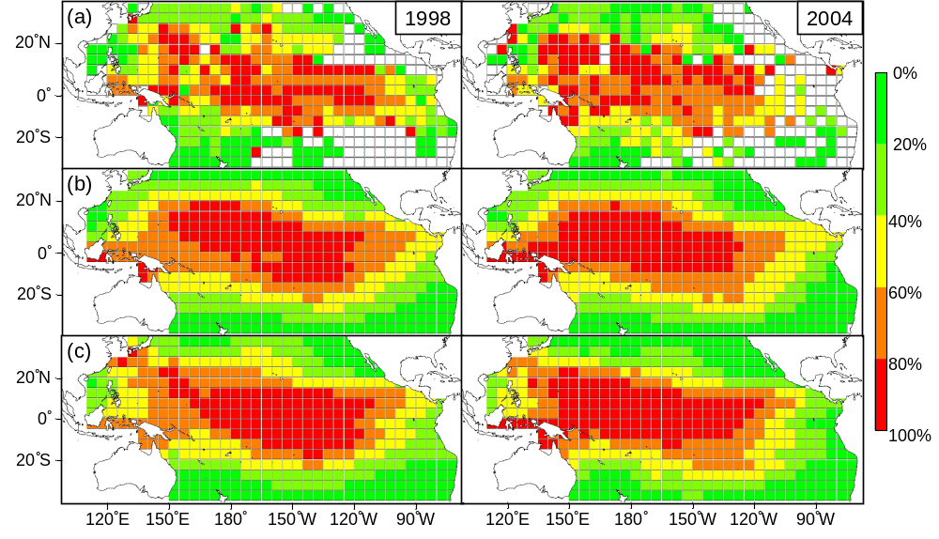
Output
Su et al. 2009 Fish. Ocean

Slide 23
Interactions-I
Interactions among variables can be important to capture
non-linear effects which are not easy to capture using
single variable models.
The number of options, however, to get large:
From Wood (2006)
m2 <- gam(medFPQ~s(Y,X,k=100),data=brain,
family=Gamma(link=log),method=gm)

Slide 24
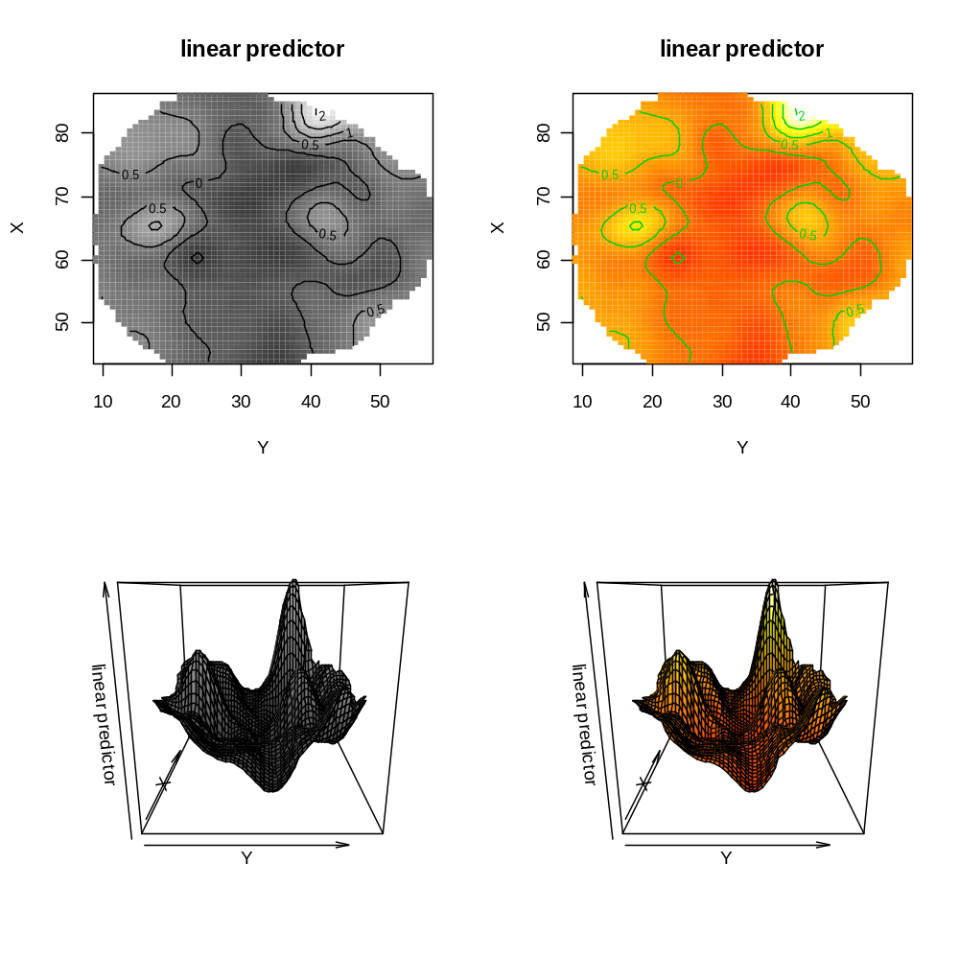
Interactions-II
vis.gam(m2,plot.type="contour",
too.far=0.03,color="gray",n.grid=60,zlim=c(-1,2))

Slide 25
GAM Packages
GAM implementations
gam in gam: not recommended
gam in mgcv: contains more of what we need
GAMM implementations
gamm in mgcv: uses nlme package
gamm4 in lme4: uses lme4 package

Slide 26
Extension to MM
GAM can be extended to GAMM in the same way (more or less)
that GLM can be extended to GLMM. However, as mentioned
before, the packages for GLMM and GAMM are under
development and the methods are necessarily approximate.
Therefore, be somewhat wary of AIC, BICs and p-values.

Slide 27
An example (from Zuur)
The Roulin and Bersier dataset is based on the begging
behaviour of owls. A number of nests were visited multiple
times and the number of calls just before the arrival of a
parent was recorded. There may be number chicks in a nest.
The data are in dataset Owls.txt.
Logically, we should consider the data to be Poisson-distributed.
I will consider a simple formulation of the problem with
“Foodtreament” and “Arrivaltime” as the only covariates.

Slide 28
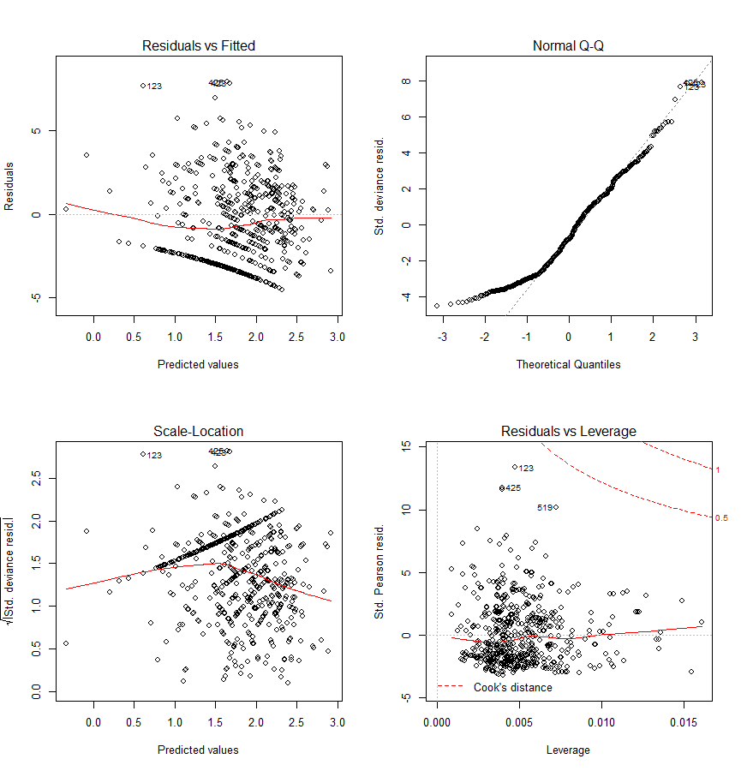
Attempt I – A Poisson GLM
# Poisson GLM
Case1 <- glm(NCalls ~ offset(LBroodSize)+FoodTreatment+ArrivalTime,data=Owls family=poisson)
print(summary(Case1))
par(mfrow=c(2,2))
plot(Case1)
Why was this apriori a
bad way to model these data?

Slide 29
Attempt II – A Poisson GLMM
# Poisson GLMM
Case2 <- lmer(NCalls ~ offset(LBroodSize)+FoodTreatment+ArrivalTime + (1|fNest),data=Owls,family=poisson)
print(summary(Case2))
par(mfrow=c(2,2))
plot(Case2)
Better: Note that some of the results differ from those
in Zuur et al.!

Slide 30
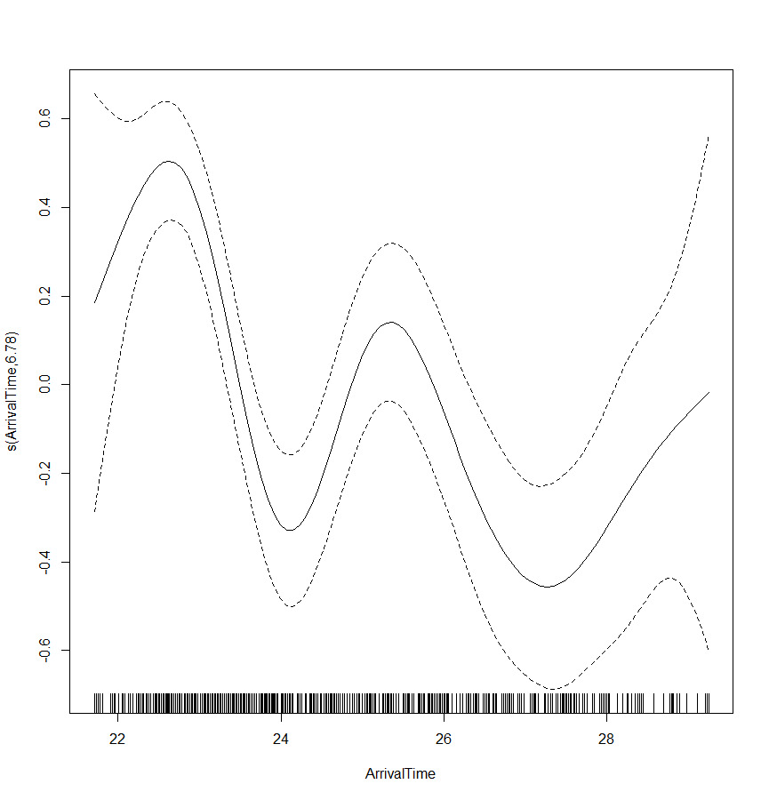
Attempt II – A Poisson GAMM
library(mgcv)
Case3<-gamm(NCalls~offset(LBroodSize)+FoodTreatment+s(ArrivalTime),random=list(fNest=~1),data=Owls,family=poisson)
summary(Case3$gam)
anova(Case3$gam)
plot(Case3$gam)

Slide 31
Call to GAMM
Fixed effects structure
Random effects structure
Correlation structure for the residuals
gamm(formula,random=NULL,correlation=NULL,family=gaussian(), data=list(), weights=NULL, subset=NULL, na.action, knots=NULL, control=list(niterEM=0,optimMethod="L-BFGS-B"), niterPQL=20,v erbosePQL=TRUE, method="ML",...)
Random components are specified as a list:
random=list(x=~1, y=~1,z=~1+life)

Slide 32
Predictions From GAMM
Use predict to make predictions using a fitted gamm model
Set to response for response on the scale of data
Note this defaults to FALSE
predict(object,newdata,type="link",se.fit=FALSE,terms=NULL, block.size=1000,newdata.guaranteed=FALSE,na.action=na.pass, unconditional=FALSE,...)

Slide 33
GAMM4
gamm4 in library gamm4 is an alternative to gamm which
should / may be more robust.
Gamm4 has a different way to specify random effects:
gamm4(y ~ s(x),random = ~ (x+0|g) + (1|g) + (1|a/b))
Nested random effects

Slide 34
References
There are plenty:
  Crawley. 2003. Statistical Computing: An Introduction to Data Analysis using S-Plus
  Venables and Ripley. 1994. Modern Applied Statistics with S-PLUS.
  Venables and Dichmont. 2004. Fish. Res. 70: 409-426
  Wood. 2006. Generalized Additive Models: An Introduction with R
  Zuur et al. 2009. Mixed Effects Models and Extensions in Ecology R
  Hastie, T., Tibshirani, R. and Friedman, J. 2009. The Elements of Statistical Learning: Data Mining, Inference, and Prediction, Second Edition.
  Available for free here: http://www-stat.stanford.edu/~tibs/ElemStatLearn/

